Slide 1

Table of Contents
What are Databases?
Relational Databases
Concept
Design
Entity-Relationship Diagrams
Database Normalization
First, Second, Third Normal Forms

Slide 2

Databases
A Database is an organized collection of data that is managed as a single unit
A database allows you to store, maintain, and retrieve important data
If a database is designed properly, it can have multiple applications

Slide 3
Databases
The database management is done by the so called Database Management Systems (DBMS)
A DBMS is a computer software application that interacts with the user, other applications, and the database itself to capture and analyze data.
There are different types of DBMS, such as:
RDBMS
ODBMS

Slide 4

Relational Databases

Slide 5

Relational Databases
A Relational Database is a collection of interrelated data based on the relational model
A Relational Database organizes data in two-dimensional tables consisting of columns and rows
The rows are often called – records, and the columns are often called – fields

Slide 6
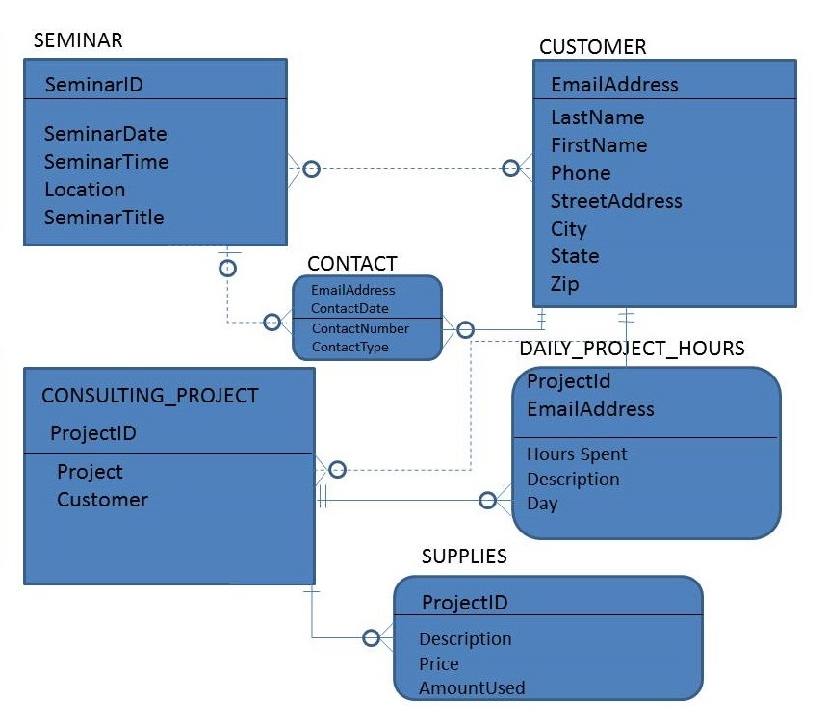
Relational Database Design

Slide 7
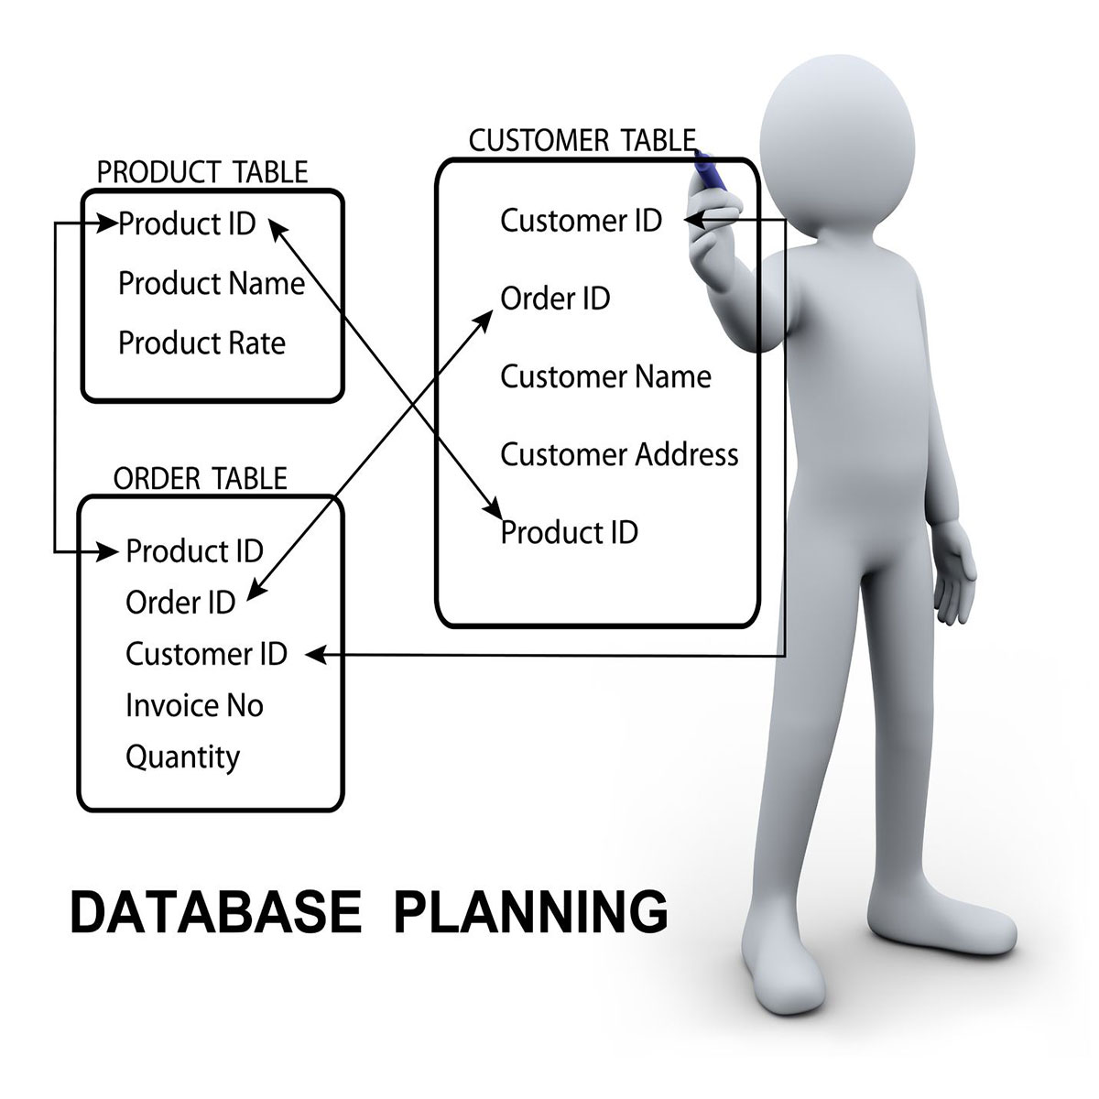
Relational Database Design
Relational database design is the process of determining the appropriate relational database structure to satisfy the current business requirements
Develop a mission
Determine the data
Divide the data into tables
Choose primary keys, Identify relationships
Apply normalization process

Slide 8
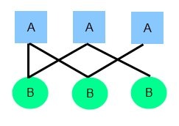
Entity-Relationship Diagrams

Slide 9
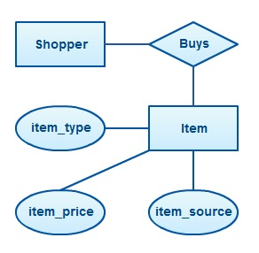
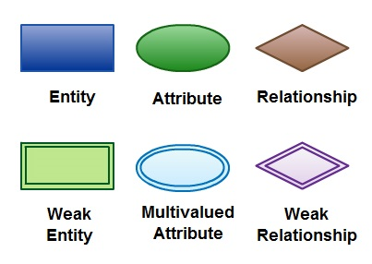
Entity-Relationship Diagrams
Entity-relationship diagrams (ERDs) are used to model entities, their attributes, and the relationships among entities.

Slide 10
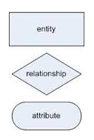
Relational Database Design
Entity-relationship modeling is a process used to create the conceptual data model of a system
The basic building blocks of an ERD are:
Entity
Attribute
Relationship

Slide 11

Mapping ERDs to a Relational Database
Demo

Slide 12

Data Normalization

Slide 13

Data Normalization
The process of Data Normalization ensures that a database design is free of any problems that could lead to loss of data integrity
There are 3 main problems (anomalies) that could appear around the database design:
Insert Anomaly
Delete Anomaly
Update Anomaly

Slide 14
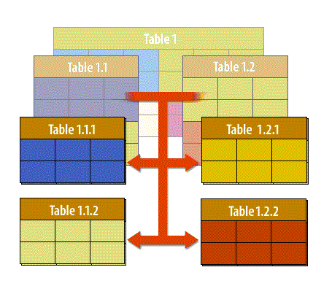
Data Normalization
There are several forms, trough which the normalization process goes, in order to avoid the appearance of any problems.
The 3 main forms of normalization we will go trough are:
First Normal Form
Second Formal Form
Third Formal Form

Slide 15
First Normal Form
First normal form (1NF) is a property of a relation in a relational database
A relation is in first normal form if:
the domain of each attribute contains only atomic (indivisible) values
the value of each attribute contains only a single value from that domain.

Slide 16
Second Normal Form
A table that is in First normal form (1NF) must meet additional criteria if it is to qualify for Second normal form (2NF).
A table is in Second normal form if:
It is in First normal form
Every non-prime attribute of the table is functionally dependent on the whole of every candidate key
Functional dependency is a constraint that describes the relationship between attributes in a relation.

Slide 17
Third Normal Form
Third normal form is a normal form that is used to reduce the duplication of data and ensure referential integrity
Third normal form is met only when:
Second normal form is met
There is no functional dependency between non-key attributes

